Slide 1
PowerPoint slides to accompany
System Dynamics, Third Edition
William J. Palm III
Using Simscape™ for Modeling Hydraulic Systems:
Dynamics of a Hydraulic Piston and Load
Copyright © 2013. The McGraw-Hill Companies, Inc.

Slide 2
These slides are intended to be used with the author’s text, System Dynamics, 3/e, published by McGraw-Hill©2014.
Acknowledgments
The author wishes to acknowledge the support of McGraw-Hill for hosting these slides, and The MathWorks, Inc., who supplied the software. Naomi Fernandes, Dr. Gerald Brusher, and Steve Miller of MathWorks provided much assistance. Dr. Brusher’s contributions formed the basis for many of the Simscape models presented here.
MATLAB®, Simulink®, and Simscape™ are registered trademarks and trademarks of The MathWorks, Inc. and are used with permission.
The equations and math symbols in these slides were created with the new equation editor in PowerPoint 2010, and thus material containing these elements will appear as graphics when viewed in an earlier version.

Slide 3
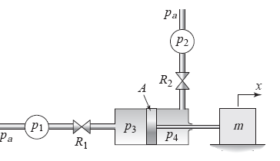
INTRODUCTION
Simscape™ extends the capabilities of Simulink® by providing tools for modeling and simulation of multi-domain physical systems, such as those with mechanical, hydraulic, and electrical components. In this presentation, we will show you how to utilize Simscape to construct models of hydraulic systems. Shown below is a double-acting piston and cylinder. The device moves the load mass m in
response to the pressure sources p₁ and p₂. Assume the fluid is incompressible, the resistances are linear, and the piston mass is included in m.

Slide 4
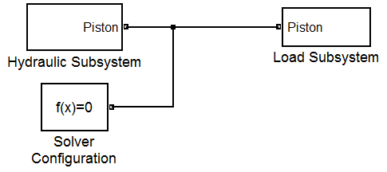
The system under consideration and the corresponding Simscape model are shown here. Note that, similar to the physical system, the system model is composed of hydraulic and mechanical subsystems coupled by the piston.
In the following slides, we will first build the hydraulic subsystem followed by the mechanical subsystem. Then, we will assemble these to form the complete system model.

Slide 5
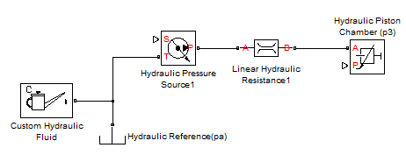
Hydraulic Subsystem
STEP 1: Select and place the Linear Hydraulic Resistance, the Hydraulic Piston Chamber, and the Hydraulic Reference blocks from the Simscape>Foundation Library>Hydraulic>Hydraulic Elements library.
STEP 2: Select and place the Hydraulic Pressure Source block from the
Simscape>Foundation Library>Hydraulic>Hydraulic Sources library.
STEP 3: Select and place the Custom Hydraulic Fluid block from the
Simscape>Foundation Library>Hydraulic>Hydraulic Utilities library.
STEP 4: Connect the blocks as shown below. This is the left-hand hydraulic network from source p₁ to piston chamber p₃.

Slide 6
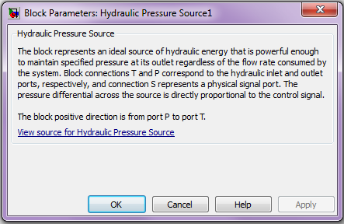
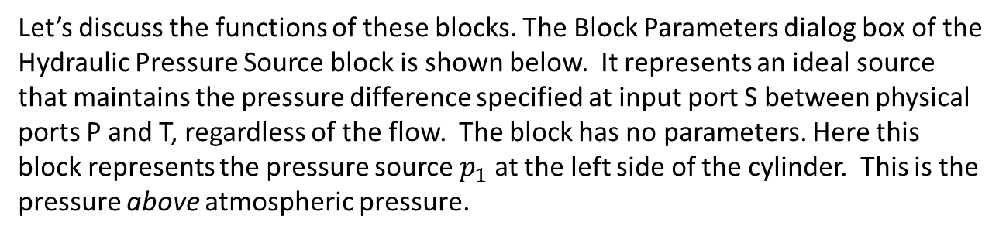
Let’s discuss the functions of these blocks. The Block Parameters dialog box of the Hydraulic Pressure Source block is shown below. It represents an ideal source that maintains the pressure difference specified at input port S between physical ports P and T, regardless of the flow. The block has no parameters. Here this block represents the pressure source $p_{1}$ at the left side of the cylinder. This is the pressure above atmospheric pressure.

Slide 7
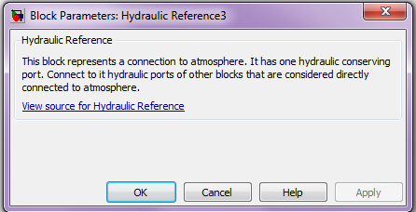
The pressure at physical port T of the Hydraulic Pressure Source block is set to atmospheric pressure by connecting Port T to a Hydraulic Reference block. The Block Parameters dialog box for the Hydraulic Reference block is shown below. The block has no parameters.

Slide 8
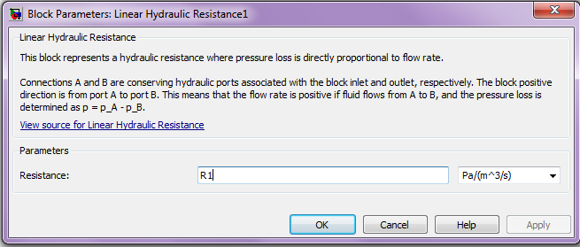
The Block Parameters dialog box of the Linear Hydraulic Resistance block is shown below. It represents a hydraulic resistance whose pressure drop p is directly proportional to its volumetric flow rate q, such that p = Rq. The positive direction is from port A to port B. The block has one parameter, the resistance R, whose units are selectable. Enter the variable name R1. Here this block represents the resistance of the inlet on the left side of the cylinder.

Slide 9
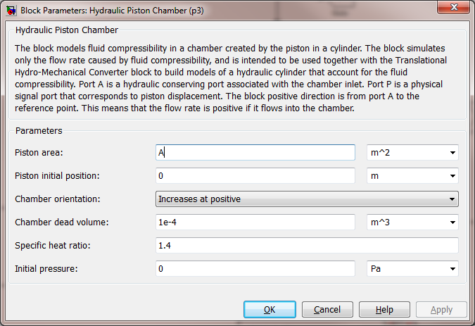
The Block Parameters dialog box of the Hydraulic Piston Chamber block is shown below. It represents the fluid volume within the cylinder on the left side of the piston. Enter the variable names and values shown in the dialog box. It is important to note that we have selected “Increases at positive” from the Chamber orientation drop-down menu, as opposed to “Decreases at positive.” This indicates that piston motion in the positive direction will increase the volume of the chamber.

Slide 10
Note: The working fluid is treated as a mixture of liquid and a small amount of entrained, undissolved gas, whose specific heat ratio is included among the parameters. This enables the model to approximately predict cavitation, but since we are considering a high-pressure system, this should not be an issue. Here we have used the default value of 1.4 for air.

Slide 11
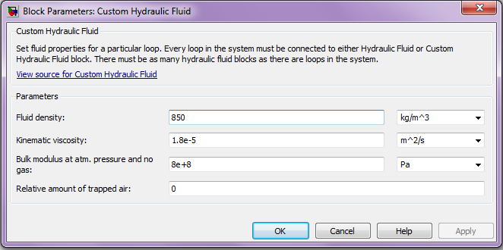
The Block Parameters dialog box of the Custom Hydraulic Fluid block is shown below. Enter the values shown. These represent a typical hydraulic fluid.

Slide 12
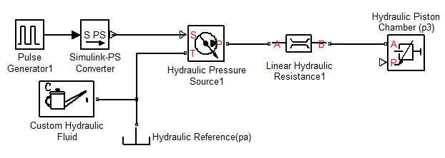
Now we will add two blocks to the model to define the profile for the pressure source p₁. Select and place the Pulse Generator block from the Simulink>Sources library. Next select and place the Simulink-PS Converter block from the Simscape>Utilities library. These blocks are discussed in the next two slides.
Connect the elements as shown below. This completes the description of the left-hand hydraulic network from source p₁ to piston chamber p₃.

Slide 13
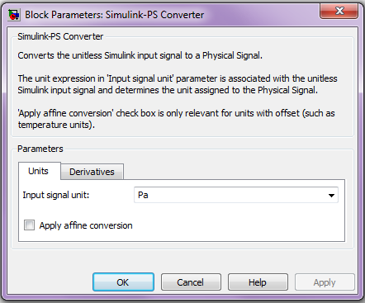
The Simulink-PS Converter block converts a unit-less Simulink signal to a physical signal (PS). Its Block Parameters dialog box is shown below. Here the input units were selected to be Pa. Connect its output to port S of the hydraulic pressure source.

Slide 14
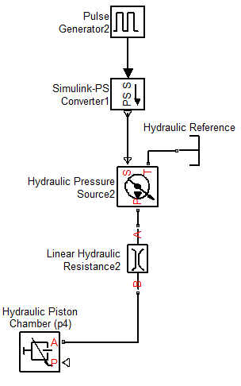
Now we must describe the hydraulic piston chamber on the right-hand side of the piston. Using the same six types of blocks previously discussed, place and connect them as shown. You can copy and paste the blocks inserted earlier.
In the Pulse Generator block, change the Amplitude variable from p1 to p2, and enter the name Delay in the Phase delay dialog box. The phase delay between the pressure inputs will enable the hydraulic system to drive the load back and forth. In the Hydraulic Resistance block, change the Resistance variable from R1 to R2. In the Hydraulic Piston Chamber block, use the same values and variables as before.

Slide 15
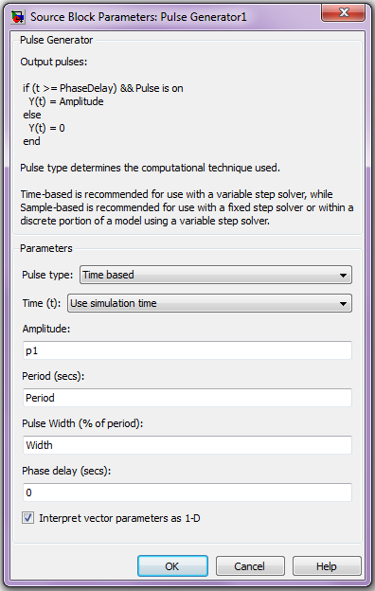
The Block Parameters dialog box of the Pulse Generator is shown to the right. Enter the variable names p1, Period, and Width where shown. This parameterization will enable us to easily consider different pressure profiles.

Slide 16
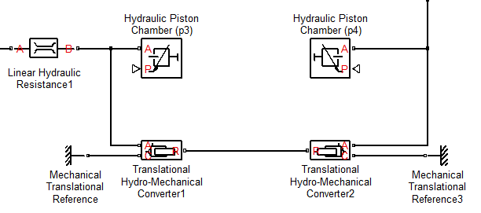
The hydraulic piston chambers determine the pressure on the left- and right-hand sides of the piston, p₃ and p₄, respectively. The pressure difference will exert a net force on the piston and drive the load mass. Thus, we must introduce elements to capture this conversion from hydraulic to mechanical power. Select and insert two Translational Hydro-Mechanical Converter blocks from the Simscape>Foundation Library>Hydraulic>Hydraulic Elements library and two Mechanical Translational Reference blocks from the Simscape>Foundation Library>Mechanical>Translational Elements library. Connect port A on each Converter to the Hydraulic Piston Chamber blocks from the previous diagram, as shown in the figure. If you right-click on the block and select the submenu “Format,” you will find options to reorient the blocks.

Slide 17
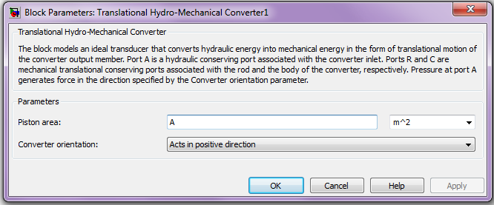
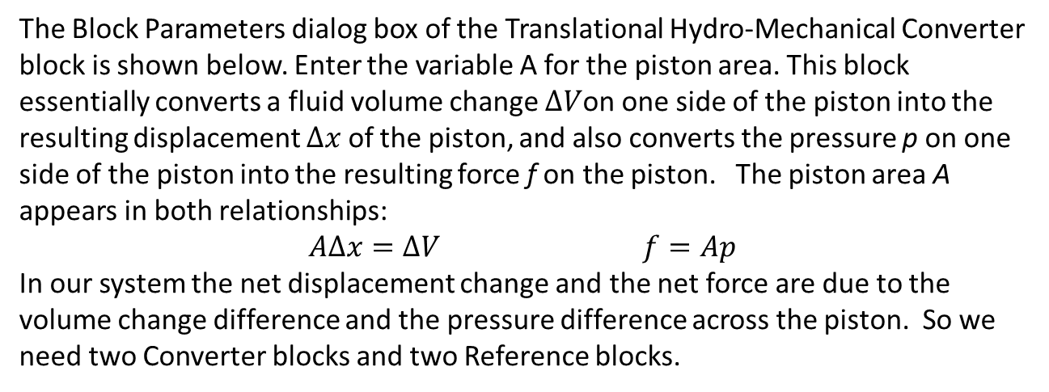
The Block Parameters dialog box of the Translational Hydro-Mechanical Converter block is shown below. Enter the variable A for the piston area. This block essentially converts a fluid volume change $∆V$on one side of the piston into the resulting displacement $∆x$of the piston, and also converts the pressure p on one side of the piston into the resulting force f on the piston. The piston area A appears in both relationships:
$$A∆x=∆V f=Ap$$
In our system the net displacement change and the net force are due to the volume change difference and the pressure difference across the piston. So we need two Converter blocks and two Reference blocks.

Slide 18
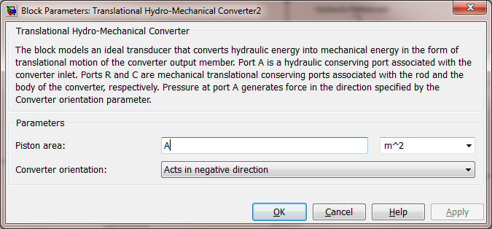
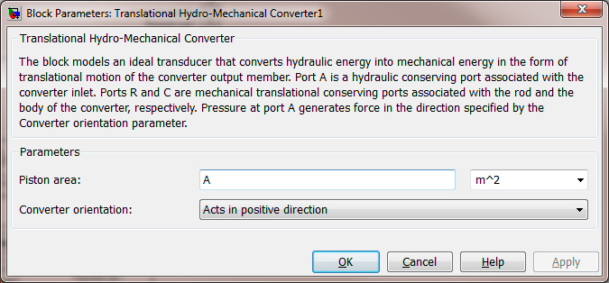
It is important to note that we have specified opposite directions for the forces generated by the pressures acting at the “A” ports of the respective hydro-mechanical converters. Recalling the original system diagram, p₃ will exert a force in the positive x direction, while p₄ will exert a force in the negative x direction. The Converter orientation in the block parameters dialog box is selected accordingly for each element. Thus, the power delivered by the hydraulic system to the PMC port 2 represents the net effect of these opposing forces.
p₃ (left-hand side)
p₄ (right-hand side)

Slide 19
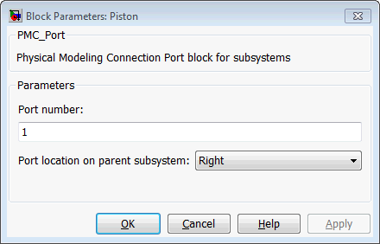
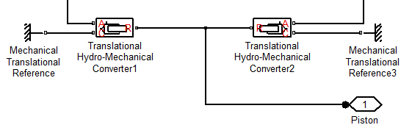
Next insert a Physical Modeling Connection Port block (PMC_Port) from the Simscape>Utilities library. Place and connect it as shown below. Label it Piston. Open the Block Parameters dialog box of the PMC_port block, and enter 1 for the port number and select Right for the port location. This will identify its connection to another part of the diagram (the load subsystem in our case).

Slide 20
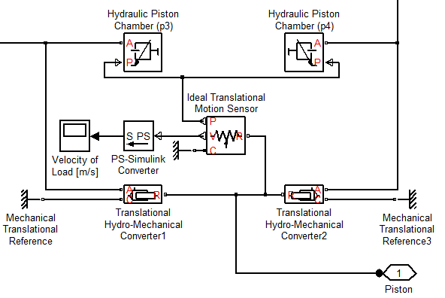
The size of the piston chambers is controlled by the displacement of the piston. We need to use a sensor to measure the displacement of the piston and provide that information to the Hydraulic Piston Chambers. Select and place the Ideal Translational Motion Sensor block from the Simscape>Foundation Library> Mechanical>Mechanical Sensors library and a Mechanical Translational Reference block from the Simscape>Foundation Library>Mechanical>Translational Elements library as shown below. Connect the P output of the sensor to the input of each Hydraulic Piston Chamber as shown below
Insert a PS-Simulink Converter block from the Simscape>Utilities library and connect it to the V port of the sensor as shown below. This block converts a physical signal (PS) to a unit-less Simulink output signal. Connect the output of this block to a Scope.

Slide 21
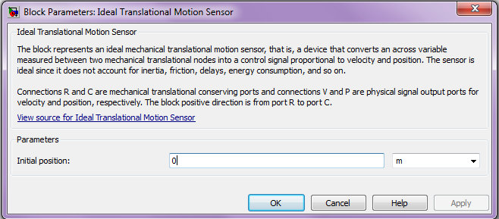
The Block Parameters dialog box of the Ideal Translational Motion Sensor block is shown below. It has one parameter, the Initial position, whose units are selectable. Enter 0 (in units of meters) for the Initial position. The C port provides the reference frame. The V output port gives the velocity signal, and the P output port gives the position signal.

Slide 22
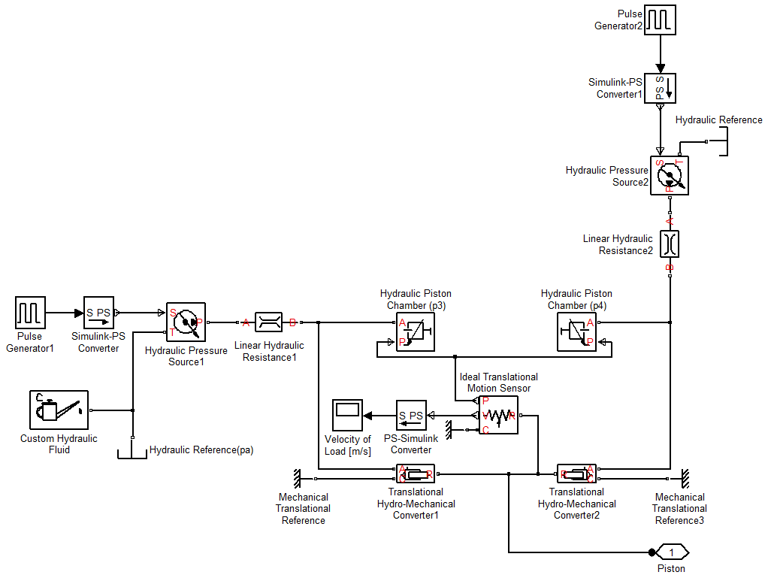
The model of the hydraulic subsystem should now appear as shown.

Slide 23
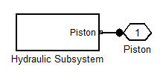
Because this diagram is getting rather detailed, we will now create a subsystem to represent our model thus far. Use a standard Simulink method to do this. For example, use the mouse to enclose all the elements in a bounding box and then select Create Subsystem from the Edit window. You should see the following model after you change the label to Hydraulic Subsystem and reorient the block.

Slide 24
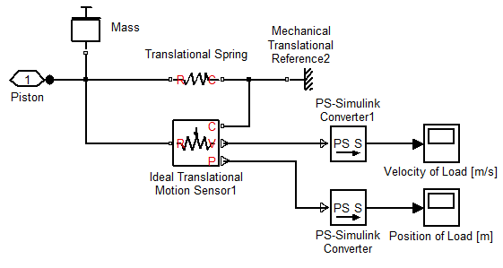
Now we are ready to model the purely mechanical part of the system. This consists of the load mass and a spring, which we have added to provide a restoring force on the piston to center it when the pressures are no longer applied. The model of this subsystem is shown below.

Slide 25
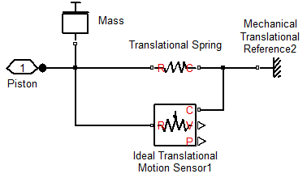
Select and place the Mass, Mechanical Translational Reference, and Translational Spring blocks from the Simscape>Foundation Library>Mechanical>Translational Elements library. Select and place the Ideal Translational Motion Sensor block from the Simscape>Foundation Library>Mechanical>Mechanical Sensors library. Then select, place, and label a PMC port as shown. Connect them as shown below.
Note that the power-conserving connection between the piston port, mass, and spring enforces the constraint that the motion of the mass and piston must be identical.

Slide 26
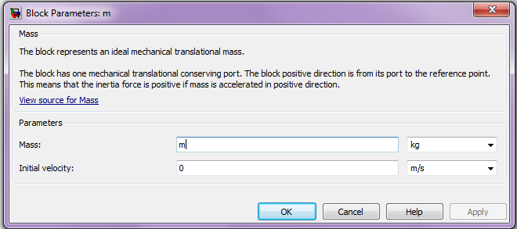
The definition of the Mass block is shown in the Block Parameters dialog box. It has two parameters: its mass value, whose units may be selected, and its initial velocity, also specified in selectable units. Enter the variable name m for the mass and 0 for the Initial velocity. Make sure the units are kg and m/s, respectively.

Slide 27
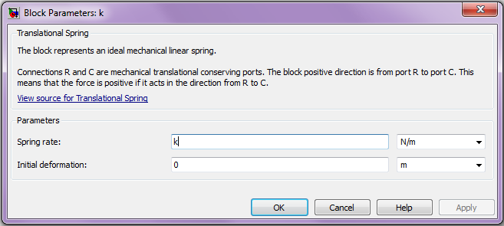
The definition of the Translational Spring block is shown in the Block Parameters dialog box. It has two parameters: its spring rate (also called its spring constant), and its initial deformation (which is positive if the spring is compressed). The units for both parameters are selectable. Enter k for the Spring rate and 0 for the Initial deformation in units of N/m and m, respectively.

Slide 28
Now select and insert two PS-Simulink Converter blocks from the Simscape>Utilities library. This block converts the input physical signal (PS) to a unit-less Simulink output signal. Connect the inputs to the P and V ports of the motion sensor. Then connect two Scopes as shown.

Slide 29

Now create a subsystem model as done previously for the Hydraulic Subsystem. You should see the following model after you change the subsystem block label to Load Subsystem.

Slide 30
To assemble the system model, delete the port symbols and connect the input and output ports as shown. Notice that the port names match. (This may require editing of PMC port connection names inside one of the subsystems.) Now select and insert a Solver Configuration block from the Simscape>Utilities library. This block will be discussed on the next two slides.

Slide 31
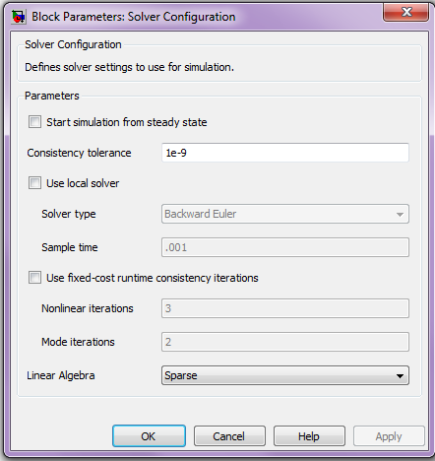
The Solver Configuration block defines the solver settings for this Simscape physical network. The Simulink solver for the entire model must be set separately. Its Block Parameters dialog box is shown below. For this example, do not change any of the parameters in this block (all three boxes should be unchecked).

Slide 32
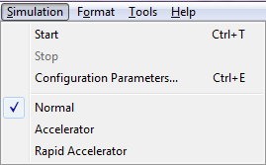
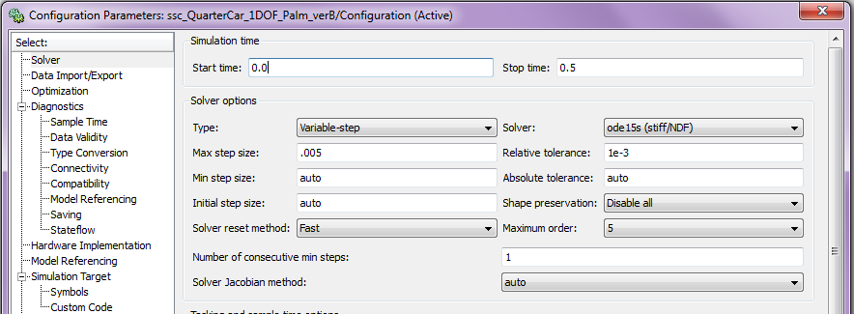
A Note About Solvers: The default solver is ode 45. It is strongly recommended that you change the solver to a stiff solver (ode15s, ode23t, or ode14x). Do this by selecting “Configuration Parameters” from the Simulation menu, selecting the solver pane from the list on the left, and changing the “Solver” parameter to ode15s. Then click OK.

Slide 33
Setting the Parameter Values: In addition to specifying the Stop Time, to run the simulation we must specify the numerical values of the various parameters. One way to do this is to assign values to the variables in the MATLAB Command window.
However, if you are going to share the model file, a more convenient way is to store the values in the model file itself. You could do this by typing the values in the Block Parameter dialog boxes, but then you would not have the variables available for use in another program.
To store the values in the model file, you can create a MATLAB® script by selecting Model Properties/Callbacks/InitFcn from the File menu of the model window. We will show how to do this on the following slides.

Slide 34
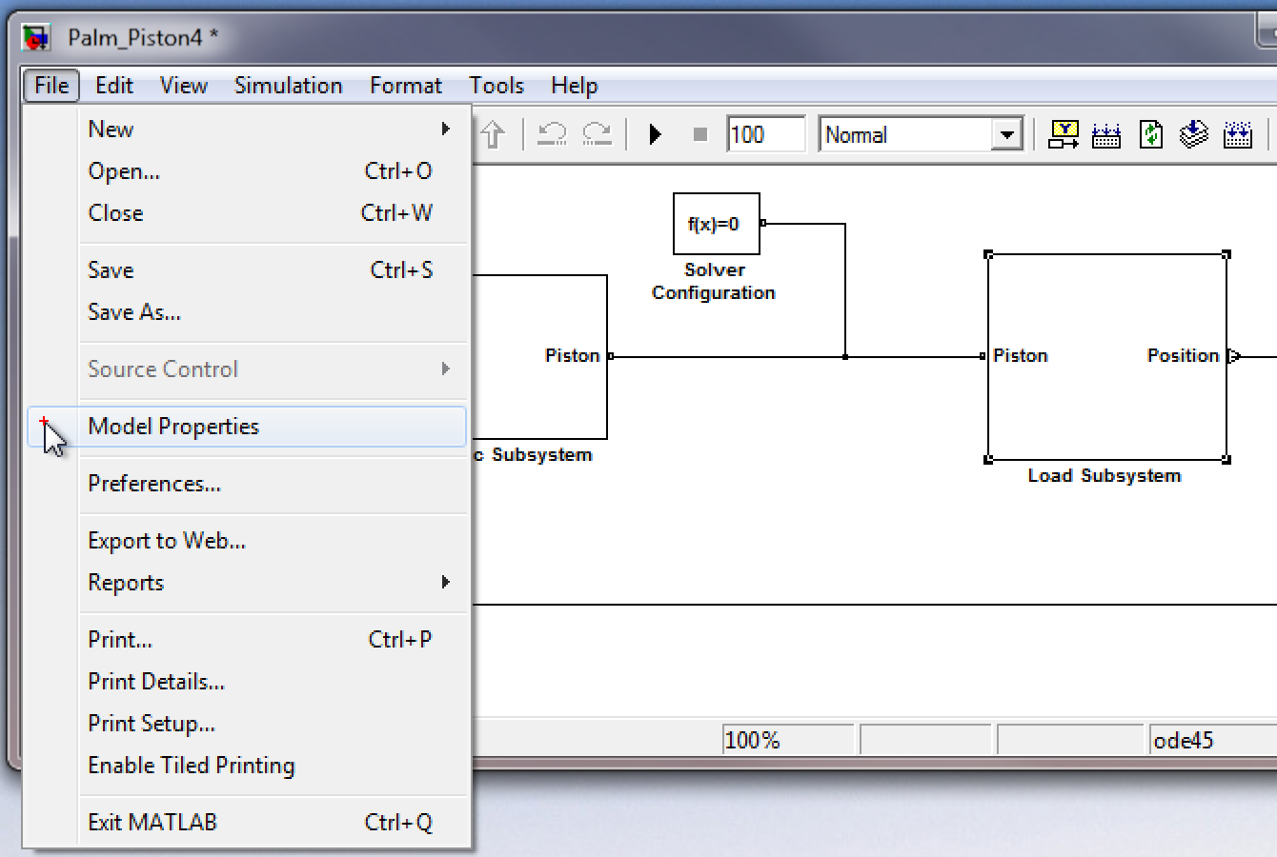
In the Simulink model window, select Model Properties from the File menu:

Slide 35
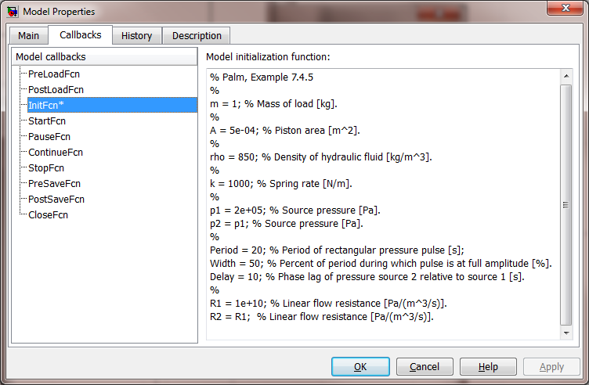
This will bring up the Model Properties dialog box. Select the Callbacks tab.
Select InitFcn from the list of Model callbacks. Then, type MATLAB commands into the pane under Model initialization function. These commands will execute at the start of model simulation. Note that an asterisk will appear next to a callback function that has commands written into it.
Type MATLAB commands here.
You then type in the script shown on the next slide. This script could also be created in the MATLAB editor and pasted into the InitFcn window.

Slide 36
InitFcn commands for Hydraulic Piston and Load example.
% Values for Example 7.4.7 in Palm, System Dynamics, 3/e.
%
m = 1; % Mass of load [kg].
%
A = 5e-04; % Piston area [m^2].
%
rho = 850; % Density of hydraulic fluid [kg/m^3].
%
k = 1000; % Spring rate [N/m].
%
p1 = 2e+05; % Source pressure [Pa].
p2 = p1; % Source pressure [Pa].
%
Period = 20; % Period of rectangular pressure pulse [s];
Width = 50; % Percent of period during which pulse is at full amplitude [%].
Delay = 10; % Phase lag of pressure source 2 relative to source 1 [s].
%
R1 = 1e+10; % Linear flow resistance [Pa/(m^3/s)].
R2 = R1; % Linear flow resistance [Pa/(m^3/s)].

Slide 37
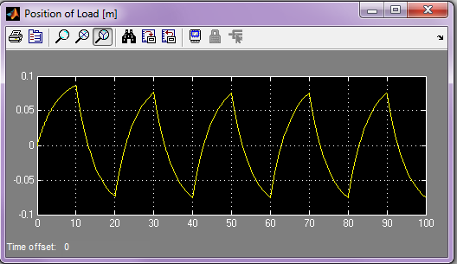
This completes the model. Set the Stop Time to 100 and run the simulation. Since we have embedded the Scope in the Load Subsystem, we must double click on that subsystem to see the Scope. Double click on the Scope. You should see the following display.
This completes the presentation.

